Slide 1
Diyala University College of Engineering Fourth Year 2012/2013 Computer & Software Engineering Department
ENCRYPTION AND DATA
SECURITY
Chapter2: Part1
PRESENTED BY
DR. ALI J. ABBOUD

Slide 2
TEXTBOOKS
Applied Cryptography – 2nd edition
Bruce Schneier Available online.
Security In Computing – 4th edition Pfleeger and Pfleeger.
http://www.wikipedia.org/
Papers assigned for reading

Slide 3
CLASS STRUCTURE
Chapter 1: Introduction to encryption and Data security.
Chapter 2: Encryption systems.
Chapter 3: Secure encryption systems.
Chapter 4: Security involving programs.
Chapter 5: Protection Services for users of operating systems.
Chapter 6: Data Base security.
Chapter 7: Computer Network Security.
Chapter 8: Communication Security.

Slide 4
Chapter 2: Encryption Systems
• 2.1 Terminology and Background
• 2.2 Substitution Ciphers
• 2.3 Transpositions (Permutations)
• 2.4 Making “Good” Encryption Algorithms
• 2.5 The Data Encryption Standard (DES)
• 2.6 The AES Encryption Algorithm
• 2.7 Public Key Encryption
• 2.8 Uses of Encryption
• 2.9 Summary

Slide 5
In This Chapter
important tool
• rooted in some heavy-duty math
– number theory
– group & field theory
– computational complexity
– probability
• our goal:
– be able to intelligently use cryptosystems
– not design/break cryptosystems

Slide 6
Block it, by preventing its reaching R, thereby affecting the availability of the message.
Intercept it, by reading or listening to the message, thereby affecting the confidentiality of the message.
Modify it, by seizing the message and changing it in some way, affecting the message's integrity.
Fabricate an authentic-looking message, arranging for it to be delivered as if it came from S, thereby also affecting the integrity of the message.

Slide 7
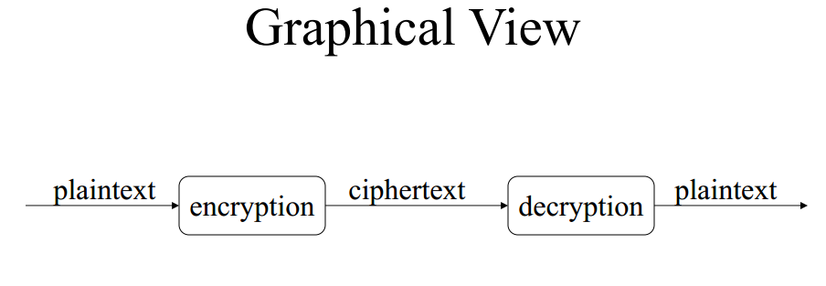

Slide 10
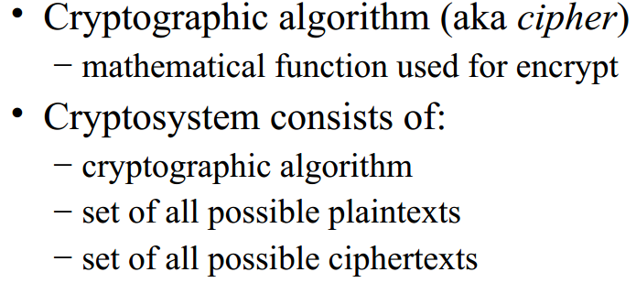

Slide 11
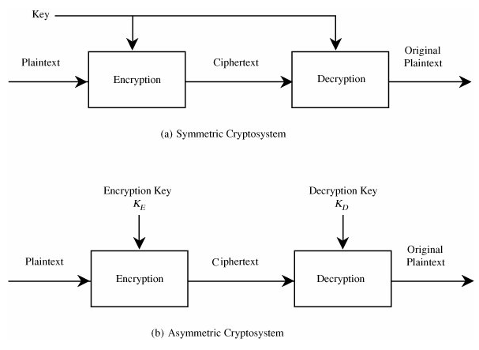
Encryption Algorithms

Slide 12
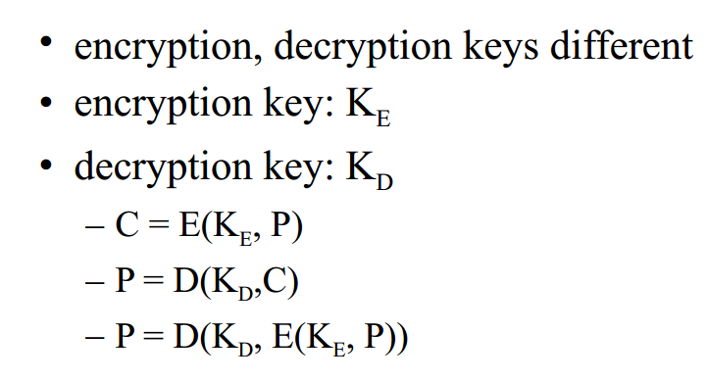
Asymmetric Algorithm

Slide 13
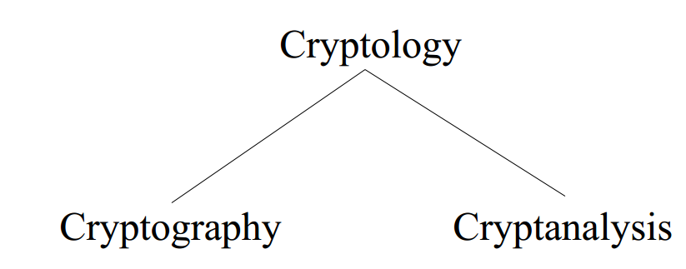
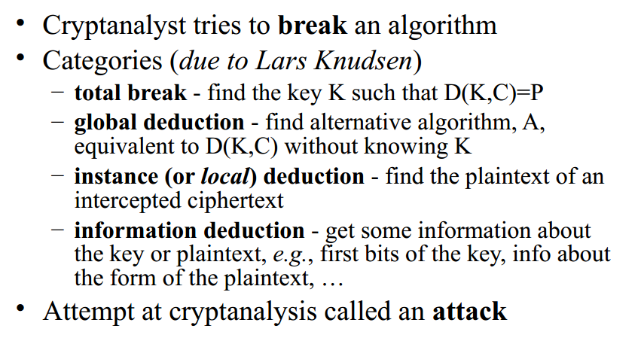
Cryptanalysis

Slide 17
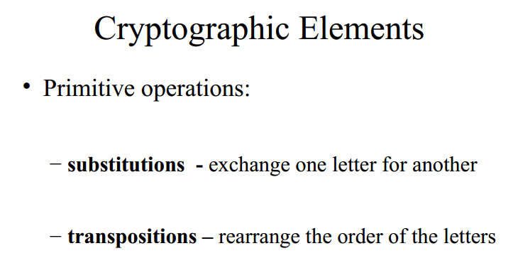

Slide 22
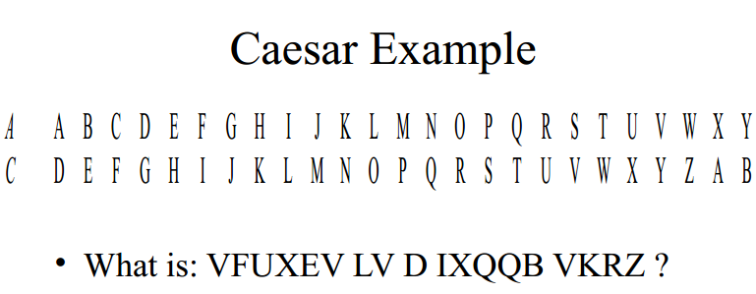

Slide 26
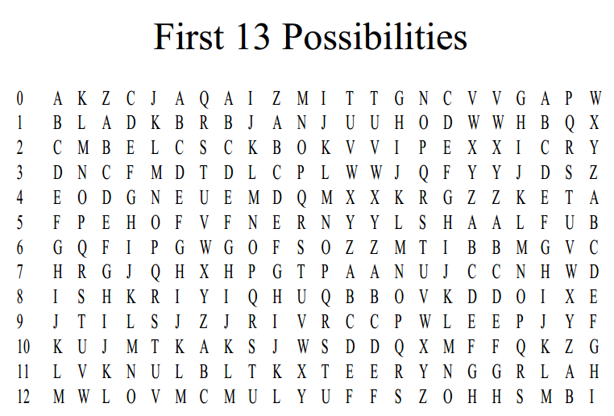

Slide 27
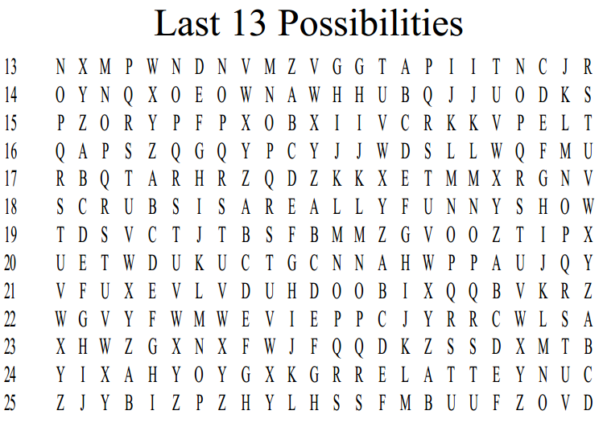

Slide 32
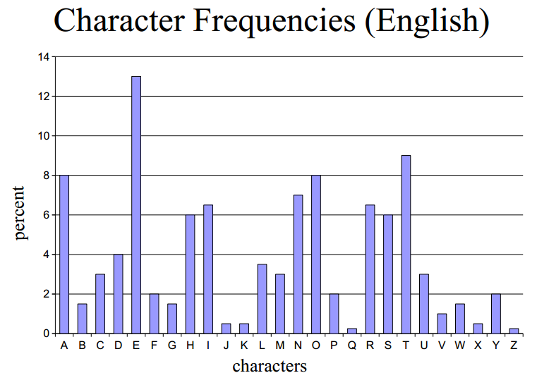

Slide 33
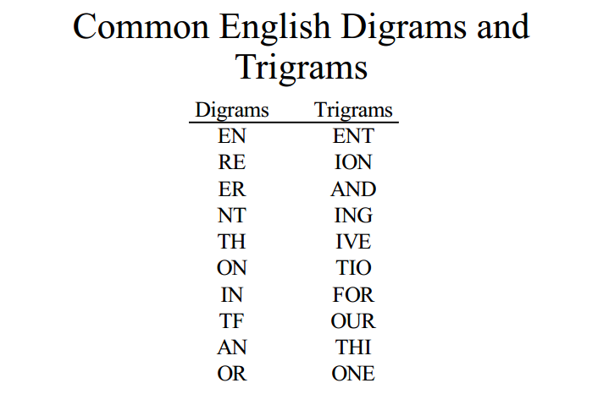

Slide 34
End of Chapter2/ Part1

